Slide 1
Compre Tips
Focus on both pre-midsem and post-midsem topics
Approximately 10-20% pre-midsem topics
80-90% post midsem topics
Among post midsem topics, focus on LIME, Shapley/SHAP and gradient based techniques for visualization/robustness/privacy
Among pre midsem topics, focus on fairness metrics, preprocessing, counterfactuals and debiasing for NLP/vision.
Review problems discussed in class / midsem solutions and in this deck (problems from previous papers)
Expected to use basic concepts from ML/DNN courses (e.g., loss function, weighted regression, minimization of loss functions, backprop, SGD etc.)
Note: This deck will not be included in BITS watermarked exam materials!!!

Slide 2
Consider DP-SGD is being used to train a logistic regression based classifier of the form, output = 1/(1+exp(-w0-w1*x1-w2*x2)). All parameters w0, w1 and w2 of the classifier are initialized to 0. Mini-batch size is chosen to be 4, and gradient norm bound is chosen to be 0.6. What will be the expected value of gradient vector after first iteration? Show all calculation steps clearly.
Data Instance # | Input x1 | Input x2 | Target y
1 | 0 | 0 | 0
2 | 0 | 1 | 0
3 | 1 | 0 | 0
4 | 1 | 1 | 1

Slide 3
 |  |  |  | w0 | w1 | w2
 |  |  |  | 0 | 0 | 0
Data Instance # | Input x1 | Input x2 | Target y | Actual Output | dL/dw0 | dL/dw1 | dL/dw2 | L2 norm of gradient | Clipped L2 norm
1 | 0 | 0 | 0 | 0.5 | 0.5 | 0 | 0 | 0.5 | 0.5
2 | 0 | 1 | 0 | 0.5 | 0.5 | 0 | 0.5 | 0.707107 | 0.6
3 | 1 | 0 | 0 | 0.5 | 0.5 | 0.5 | 0 | 0.707107 | 0.6
4 | 1 | 1 | 1 | 0.5 | -0.5 | -0.5 | -0.5 | 0.866025 | 0.6
 |  |  |  |  |  |  |  |  | 0.575
 |  |  |  |  |  |  |  |  | Avg grad

Slide 4
Assume federated learning setting with the following training set. Data instance # 1 and #4 are processed by first node and #2 and #3 are processing by the second node. All parameters are initialized to 0 and learning rate is 0.6. What will be the value of parameters after 1st iteration if FedSGD is used?
Data Instance # | Input x1 | Input x2 | Target y
1 | 0 | 0 | 0
2 | 0 | 1 | 0
3 | 1 | 0 | 0
4 | 1 | 1 | 1

Slide 5
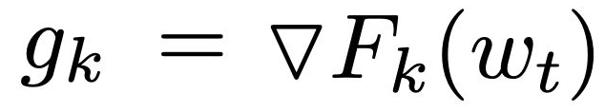
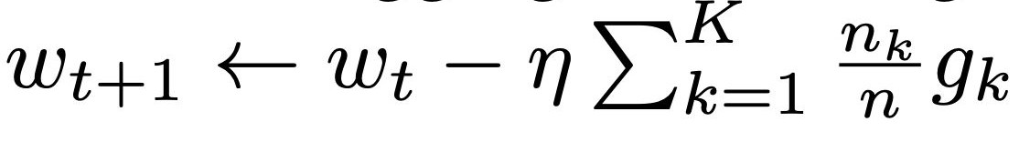
Data Instance # | Input x1 | Input x2 | Target y | Actual Output | dL/dw0 | dL/dw1 | dL/dw2
1 | 0 | 0 | 0 | 0.5 | 0.5 | 0 | 0
2 | 0 | 1 | 0 | 0.5 | 0.5 | 0 | 0.5
3 | 1 | 0 | 0 | 0.5 | 0.5 | 0.5 | 0
4 | 1 | 1 | 1 | 0.5 | -0.5 | -0.5 | -0.5

Slide 6
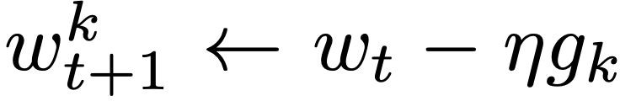
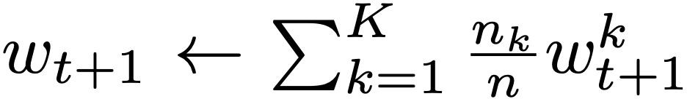
If FedAvg is used?
Data Instance # | Input x1 | Input x2 | Target y | Actual Output | dL/dw0 | dL/dw1 | dL/dw2
1 | 0 | 0 | 0 | 0.5 | 0.5 | 0 | 0
2 | 0 | 1 | 0 | 0.5 | 0.5 | 0 | 0.5
3 | 1 | 0 | 0 | 0.5 | 0.5 | 0.5 | 0
4 | 1 | 1 | 1 | 0.5 | -0.5 | -0.5 | -0.5
Node 1 Weight w0 | Node 1 Weight w1 | Node 1 Weight w1 | Node 2 Weight w0 | Node 2 Weight w1 | Node 2 Weight w2 | New Weights
0 | 0.15 | 0.15 | -0.3 | -0.15 | -0.15 | -0.15 | 0 | 0

Slide 7
Consider a logistic regression based classifier being trained with the usual log-loss function on the dataset shown below. At a particular iteration, all the parameters of the network have the value 0.5.
If one-step untargeted Fast Gradient Sign Method is used, calculate the adversarial input sample. ϵ = 0.6.
If one-step targeted Fast Gradient Sign Method is used, calculate the adversarial input sample. Data Instance #1 is targeted, i.e., target y for instance #1 is set to 1. Rest of the true values are unchanged. ϵ = 0.6.
Data Instance # | Input x1 | Input x2 | True y
1 | 0 | 0 | 0
2 | 0 | 1 | 0
3 | 1 | 0 | 0
4 | 1 | 1 | 1

Slide 8
Data Instance # | Input x1 | Input x2 | True y | Actual y | dLoss/dw1 | dLoss/dw2 | x1_adv | x2_adv
1 | 0 | 0 | 0 | 0.6224 | -0.31123 | -0.31123 | -0.6 | -0.6
2 | 0 | 1 | 0 | 0.7310 | -0.36553 | -0.36553 | -0.6 | 0.4
3 | 1 | 0 | 0 | 0.7310 | -0.36553 | -0.36553 | 0.4 | -0.6
4 | 1 | 1 | 1 | 0.8175 | 0.091213 | 0.091213 | 1.6 | 1.6
Loss= -True y *ln(actual y) - (1-True y)*ln(1-actual y)
dLoss/dx1=(true y - actual y)*w1
dLoss/dx2=(true y - actual y)*w2

Slide 9
If one-step targeted Fast Gradient Sign Method is used, calculate the adversarial input sample. Data Instance #1 is targeted, i.e., target y for instance #1 is set to 1. Rest of the true values are unchanged. ϵ = 0.6.
Data Instance # | Input x1 | Input x2 | Target y | Actual y | dLoss/dw1 | dLoss/dw2 | x1_adv | x2_adv
1 | 0 | 0 | 1 | 0.62245 | 0.18877 | 0.18877 | -0.6 | -0.6
2 | 0 | 1 | 0 | 0.73105 | -0.36553 | -0.36553 | 0.6 | 1.6
3 | 1 | 0 | 0 | 0.73105 | -0.36553 | -0.36553 | 1.6 | 0.6
4 | 1 | 1 | 1 | 0.81757 | 0.091213 | 0.091213 | 0.4 | 0.4
Loss= -Target y *ln(actual) - (1-Target y)*ln(1-actual y)
dLoss/dx1=(target y - actual y)*w1
dLoss/dx2=(target y - actual y)*w2

Slide 10
Consider the following training dataset relating features x1 (sq. ft. of a flat) and x2 (distance of the flat from the city centre) and its price y. Linear regression model is used. No scaling is used.
Calculate the standard Shapley values for a flat of 1000 sq ft. and at a distance of 4 km. Show all steps including all the models obtained for different coalitions of features, marginal contributions clearly.
Instance # | x1 (sq. ft.) | X2 (distance in km) | Y (price in lakhs of rupees)
1 | 500 | 1 | 25
2 | 750 | 2 | 35
3 | 800 | 3 | 35
4 | 1200 | 5 | 50

Slide 11
Model(NULL) = (25+35+35+50)/4=36.25
Model(x1)= 7.419+0.0355x1
Model(x2)=20.143+5.857
Model(x1,x2)=2.5+0.05x1-2.5x2
At (x1,x2)=(1000,4), prediction using
model(null)=36.25
model(x1)=7.419+0.0355*1000=42.919
model(x2)=20.143+5.857*4=43.571
model(x1,x2)=2.5+0.05*1000-2.5*4=42.5
Contribution due to x1 = 0.5*(42.919-36.25+42.5-43.571) = 2.799
Contribution due to x2 = 0.5*(43.571-36.25+42.5-42.919) = 3.451

Slide 12
Consider gender debiasing regularization for word embeddings. The following are the word embeddings. W_{g} (.) and w_{a} (.) are the gender-related and gender-neutral parts.
Word | Male seed words | Female seed words | w_{g} (1) | w_{g} (2) | w_{g} (3) | w_{a} (1) | w_{a} (2)
daughter |  | X | 0.3 | 0.5 | 0.6 | 0.3 | 0.6
son | X |  | .75 | 0.6 | 0.3 | 0.6 | 0.5
prince | X |  | 0.75 | 0.6 | 0.3 | 0.3 | 0.5
programmer |  |  | 0.3 | 0.2 | 0.6 | 0.6 | 0.2
doctor |  |  | 0.4 | 0.3 | 0.8 | 0.8 | 0.1
lawyer |  |  | 0.2 | 0.1 | 0.8 | 0.4 | 0.3

Slide 13
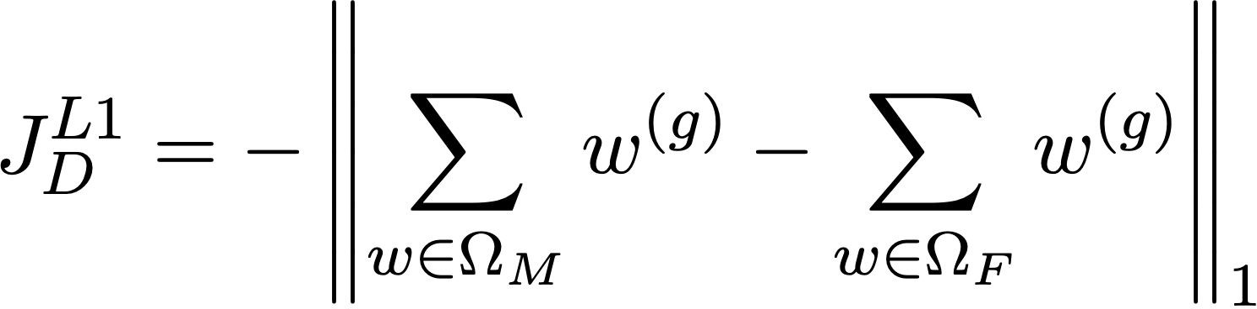
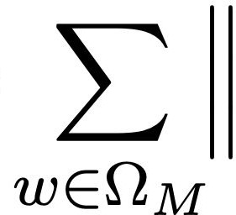
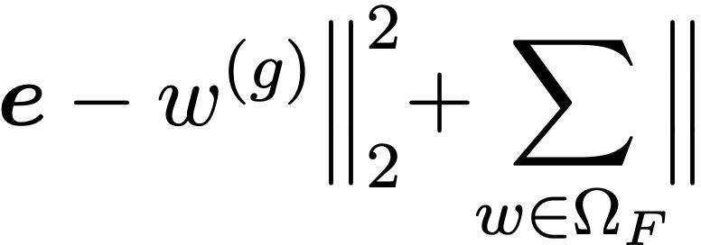

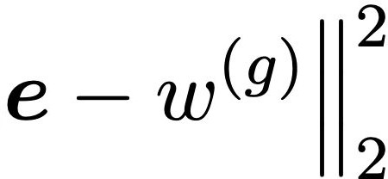


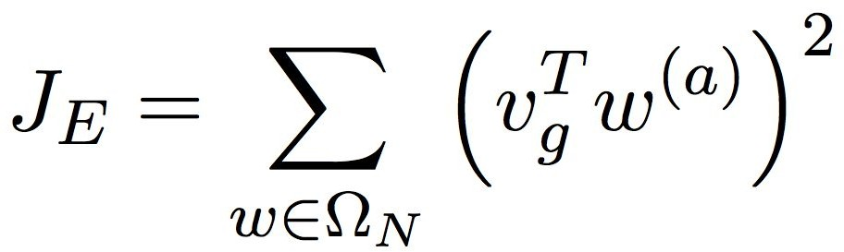
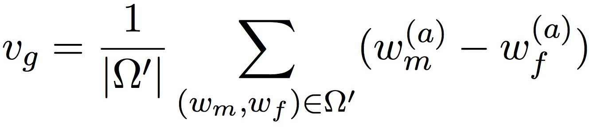
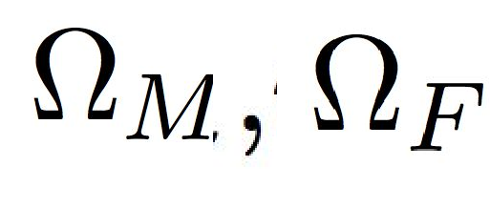
Calculate the gendered word regulating component J_{D}.
J_{D} = -|| [.75*2 0.6*2 0.3*2] – [0.3 0.5 0.6] ||₁
+ 2||[1-0.75 1 -0.6 1-0.3]||₂² + ||[-1-0.3 -1-0.5 -1-0.6]||₂²
Calculate the gender-neutral word regulating component J_{E}.
v _{g} = 1/2 *([0.6 0.5]-[.3 .6] + [0.3 0.5] - [.3 .6]
J_{E} = ¼ *(-.8*.3 +0.1*0.4-0.4*0.3+0.3*0.4)=0.05

Slide 14
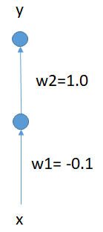
Consider DP-SGD is being used to train the following neural network. All biases are initialized to 0 and weights w1 and w2 are initialized as shown. Sigmoid activation function is used. Mini-batch size is chosen to be 2, and gradient norm bound is chosen to be 0.6. What will be the expected value of gradient vector after first iteration? Usual binary cross-entropy is used as the loss function.
Instance # | Input x | Target y
1 | 0 | 1
2 | 1 | 0

Slide 15
Input x | Target y | Hidden O | Actual O
0 | 1 | 0.5 | 0.622459
1 | 0 | 0.475021 | 0.616571
gradient b2 | gradient w2 | gradient b1 | gradient w1 | L2 Norm | Clipped Gradient
-0.37754 | -0.18877 | -0.09439 | 0 | 0.432527 | 0.432527
0.616571 | 0.292884 | 0.153758 | 0.153758 | 0.716397 | 0.6
 |  |  |  |  | 0.516264 | Average Gradient

Slide 16
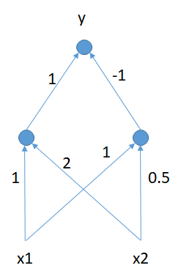
Calculate the saliency values for the input nodes for data instance #2 and #4 w.r.t. the actual output for the trained neural network shown below. All biases are 0, ReLU activation is used the hidden node and sigmoid at the output node.
Assume derivative of ReLU(x) at x=0 is 1, if needed.
Data Instance # | Input x1 | Input x2 | True y
1 | 0 | 0 | 0
2 | 0 | 1 | 0
3 | 1 | 0 | 0
4 | 1 | 1 | 1

Slide 17
Note: derivative of ReLU is 1
derivative of sigmoid function f(x) w.r.t. x is f(x)(1-f(x))
dy/dx1 = y(1-y)*(1*1-1*1)
dy/dx2 =y(1-y)*(1*2-1*0.5)
Input x1 | Input x2 | Left hidden output h1 | Right hidden output h2 | Actual y | dy/dx1 | dy/dx2
0 | 1 | 2 | 0.5 | 0.817574 | 0 | 0.22372
1 | 1 | 3 | 1.5 | 0.817574 | 0 | 0.22372

Slide 18

Apply preferential sampling to create the training data from the following
dataset. Gender is the protected attribute, P is the predictor and C is the
target class. The following neural net based ranker is used. Hidden bias
is 1 and output bias is 0, sigmoid activation is used.
Gender | P | C
F | 6 | -
F | 8 | -
F | 10 | -
F | 11 | +
M | 9.5 | -
M | 10.5 | +
M | 12 | +
M | 13 | +

Slide 19
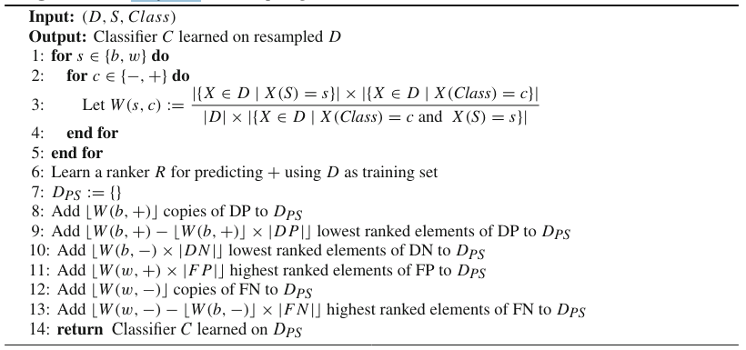

Slide 20
P | C | hidden input | hidden output | final output / ranker output | Action
6 | - | 0.4 | 0.598688 | 0.645356 | Remove
8 | - | 0.2 | 0.549834 | 0.634097 | Keep
10 | - | 0 | 0.5 | 0.622459 | Keep
11 | + | -0.1 | 0.475021 | 0.616571 | Duplicate
9.5 | - | 0.05 | 0.512497 | 0.625392 | Duplicate
10.5 | + | -0.05 | 0.487503 | 0.619518 | Keep
12 | + | -0.2 | 0.450166 | 0.610679 | Keep
13 | + | -0.3 | 0.425557 | 0.604812 | Remove

